Slide 1
SHOP FOR HOME
Capstone Project by :-
Wipro_Velocity_GCP_IP_Apr C I
Group – 8
Batch Members:
1. Pulakanam Rohitha
2. Shivansh Bhandari
3. Akash R.P
4. Kalyani Ila
5. Chayanika Mukherjee

Slide 2
Problem Statement
Shop For Home is a popular store in the market for shopping the home decor stuff. Due to Covid 19 all the offline shopping stopped. So,the store wants to move to the cloud platforms and wants their own web application.
There are 2 users on the application : -
1. User
2. Admin

Slide 3
Abstract
E-Commerce is process of doing business through computers.
A user can easily access all the facilities of the Internet to buy or sell the products.
Unlike traditional commerce that is carried out physically with effort of a person to go & get products, ecommerce has made it easier for human to reduce physical work and to save time.
User can browse online shops, compare prices and order merchandise sitting at home on their PC.
We used angular for developing the frontend part and java spring boot for backend and to store the data we used SQL.

Slide 4
Introduction
Online shopping is a form of electronic commerce which allows consumers to directly buy goods or services from a seller over the Internet using a web browser or a mobile app.
Online shops give us the opportunity to shop 24/7, and also reward us with a ‘no pollution’ shopping experience.
Online shopping can save time for both the buyer and retailer, reducing phone calls about availability, specifications, hours of operation or other information easily found on company and product pages.

Slide 5
Objective
Our existing system SHOP FOR HOME’s main objective is to allow people to buy and sell physical goods, services, and digital products over the internet. Through our SHOP FOR HOME website, a business can process orders, accept payments, manage shipping and logistics, and provide customer service.
The three main objectives are as follows :
Find the best solution for the purchase needs.
Make a purchase.
Maintain, Edit and Update the data accordingly.

Slide 6
System Specifications
Hardware Requirements : -
Operating System : Windows 7/8/10/11
Processor: Intel or AMD dual core x86 processor.
Ram: 2 GB or above.
Hard disk: 500 MB of free disk space or more.

Slide 7
Software Requirements : -
Technologies:
Angular
Java Spring Boot
Languages:
Type Script
Java
SQL Queries
IDE:
Eclipse
Vs code
MySQL

Slide 8
Functional Requirements
User Stories : -
As a user I should be able to login, Logout and Register into the application.
As a user I should be able to see the products in different categories.
As a user I should be able to sort the products.
As a user I should be able to add the products into the shopping cart.
As a user I should be able to increase or decrease the quantity added in the cart.
As a user I should be able to add “n” number of products in the cart.
As a user I should be able to get the Wish list option where I can add those products which I want but don’t want to order now.
As a user I should get different discount coupons.

Slide 9
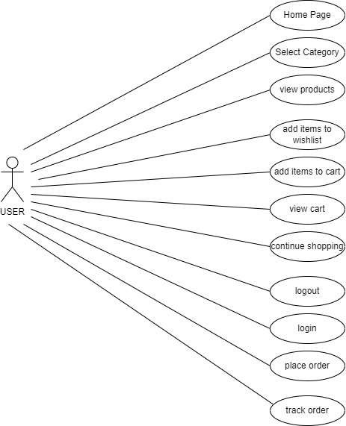

Slide 10
Admin Stories : -
As an Admin I should be able to login, Logout and Register into the application.
As an Admin I should be able to perform CRUD on Users.
As an Admin I should be able to Perform CRUD on the products.
As an Admin I should be able to get bulk upload option to upload a csv for products details.
As an Admin I should be able to get the stocks.
As an Admin I should be able to mail if any stock is less than10.
As an Admin I should be able to get the sales report of a specific duration.
As an Admin I should be able to set the discount coupons for the specific set of users

Slide 11
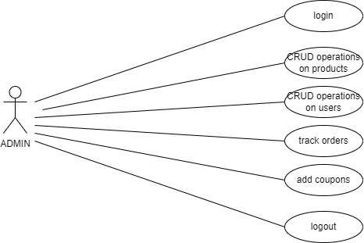

Slide 12
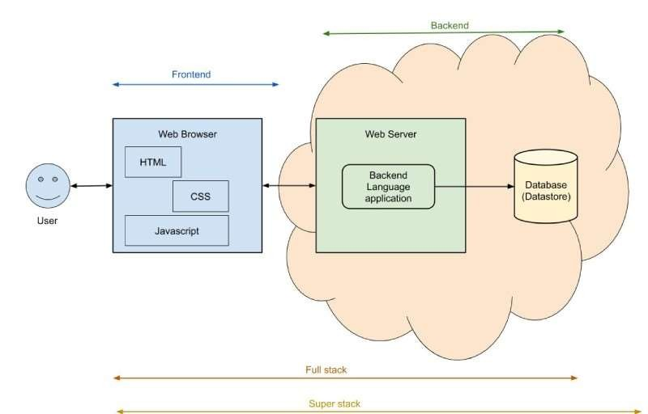
Overview of project

Slide 13
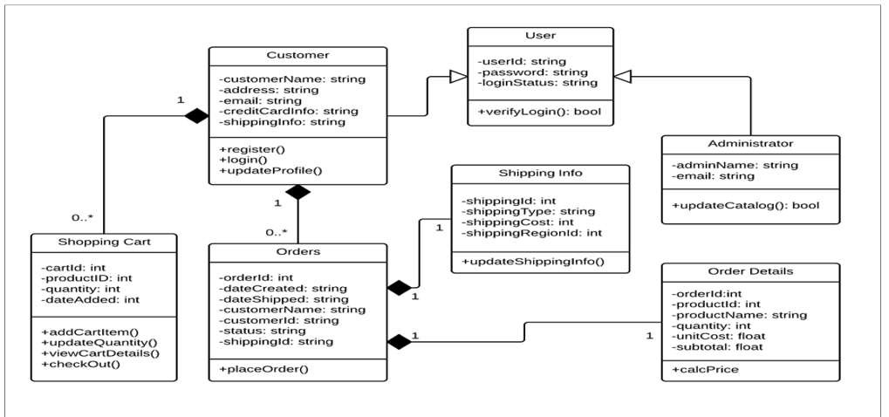
Class Diagram

Slide 14
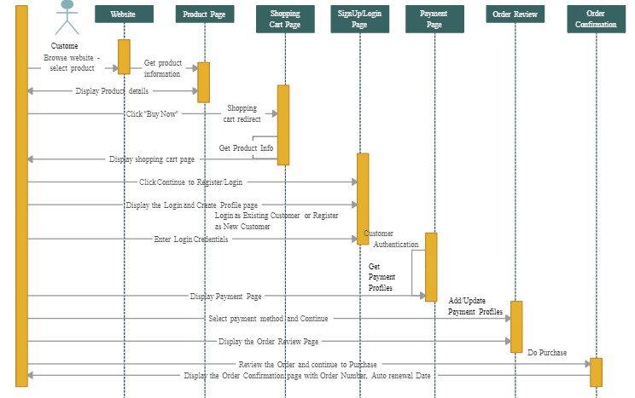
Sequence Diagram

Slide 15
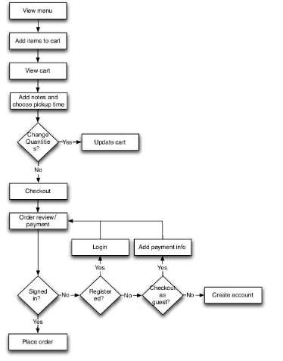
Data Flow Diagram

Slide 16
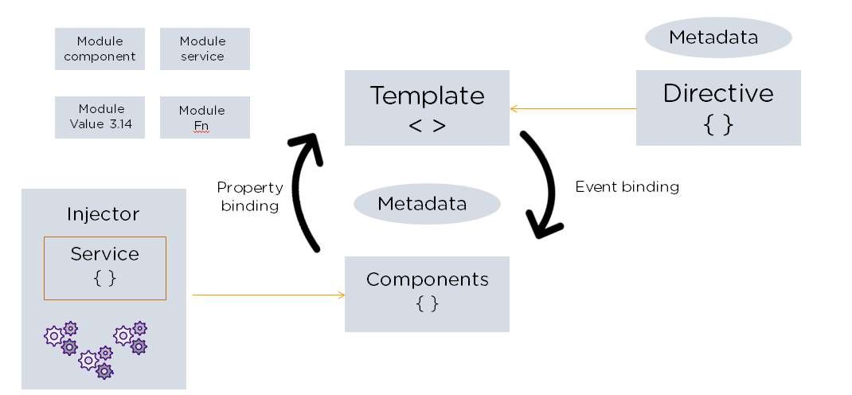
Frontend – Technology used- Angular
Angular Architecture : -

Slide 17
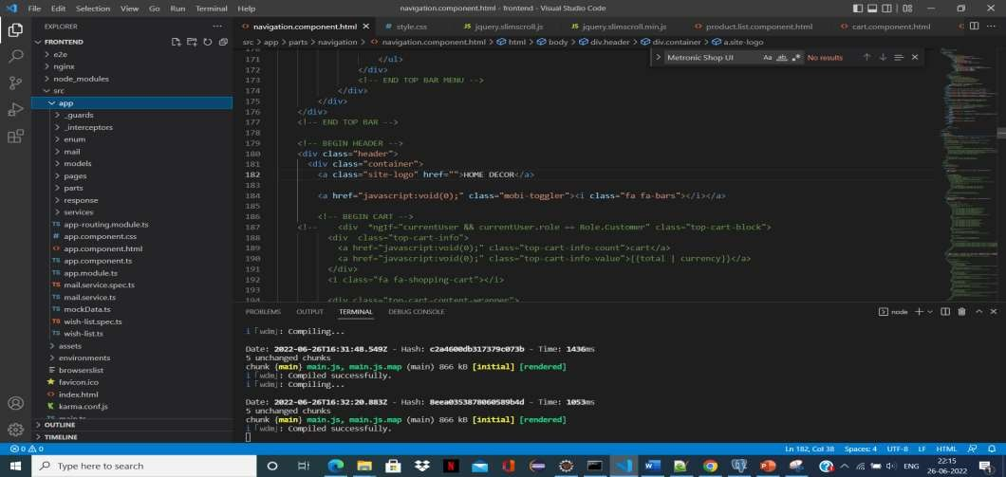
Structure of Frontend
Components
Services
Environment
Routing
Models

Slide 18
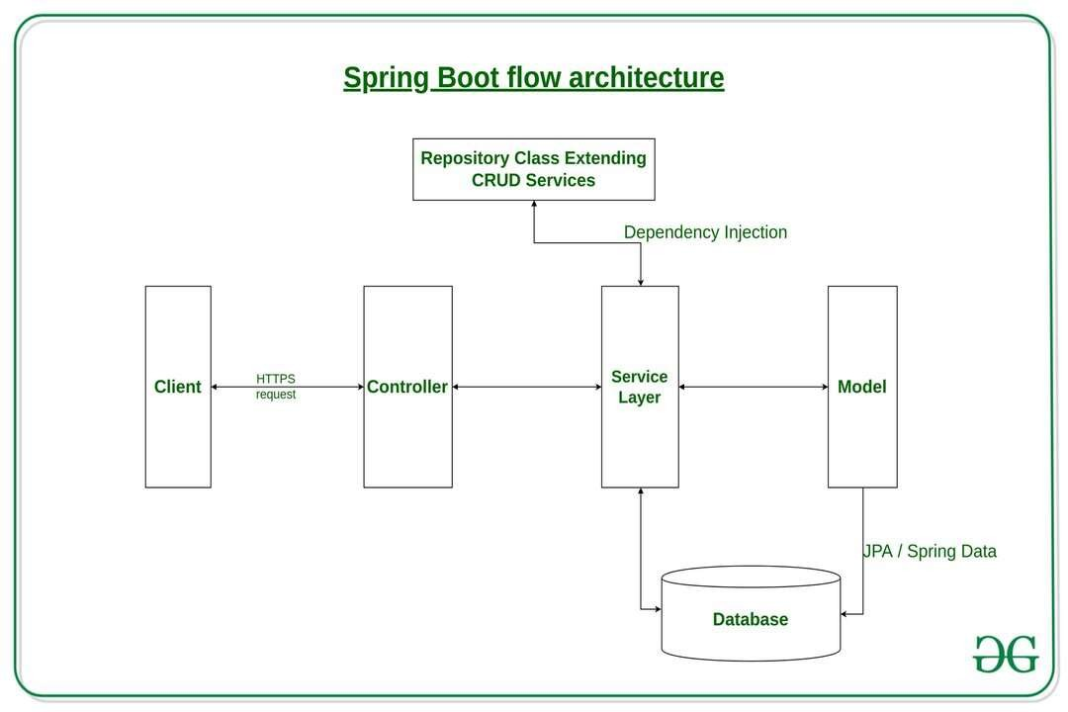
Spring Boot Architecture

Slide 19
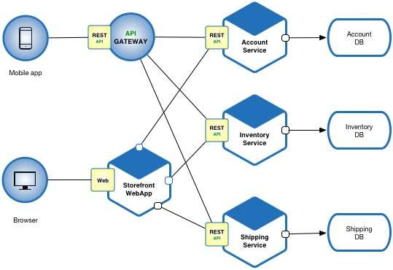
Micro service Architecture

Slide 20
Backend Technologies Used
Java
Spring Boot
SQL
Maven

Slide 21
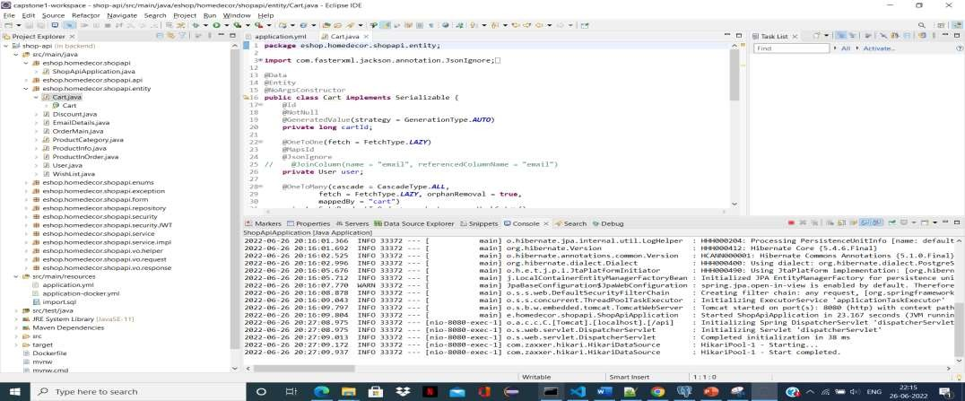
Structure of Backend
Packages :-
Main
Controller
Entity
Repository
Service

Slide 22
Database Architecture
Entities in database are: -
Cart
Discount
Order_main
Product_category
Product_in_order
Product_info
Users
Wishlist

Slide 23
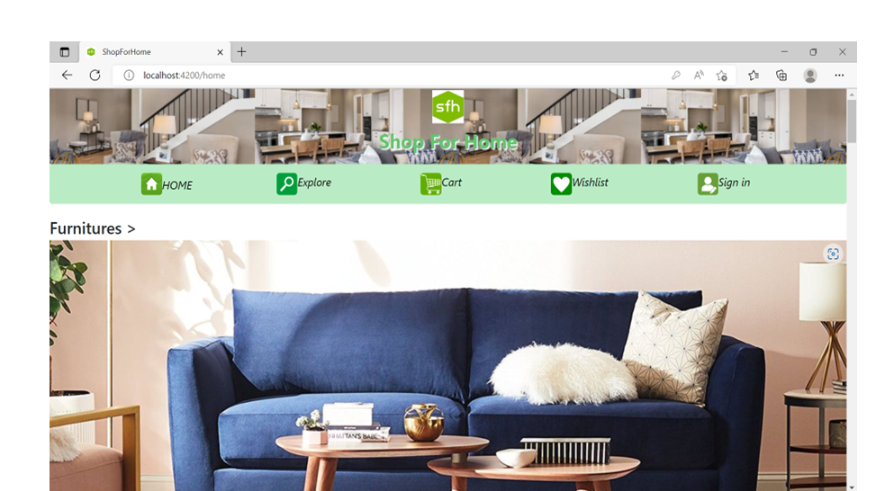
Results Home Page

Slide 24
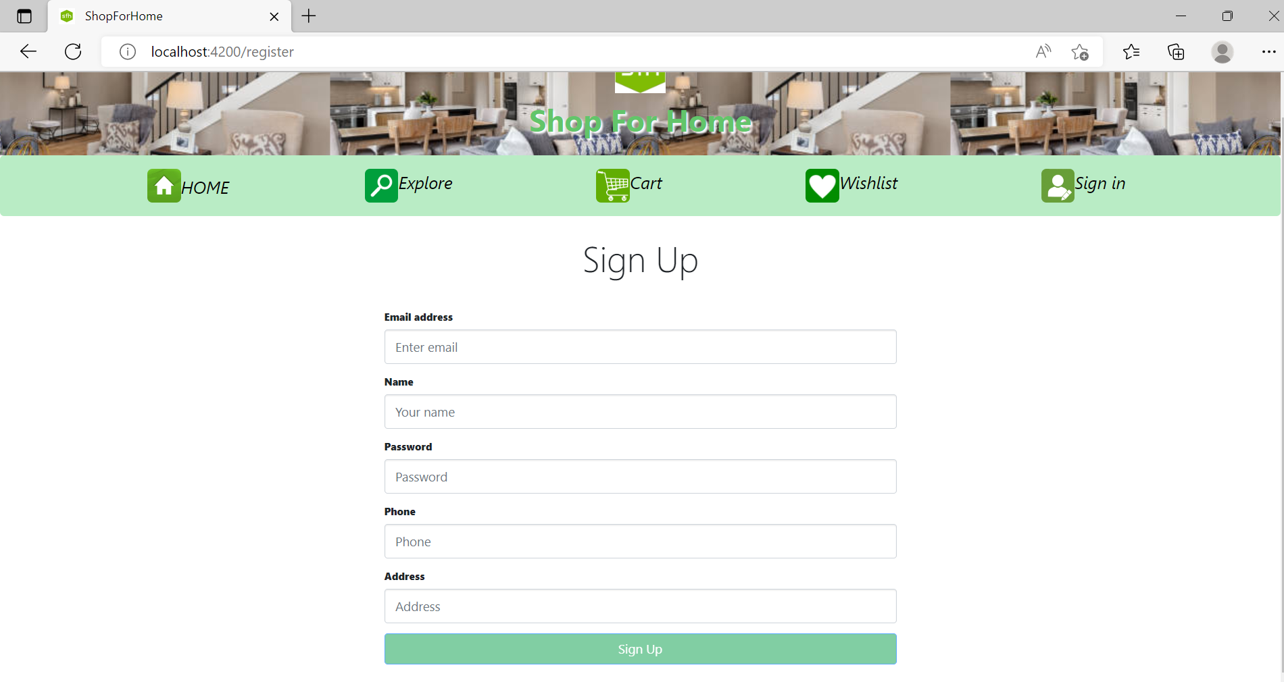
Sign Up Functionality

Slide 25
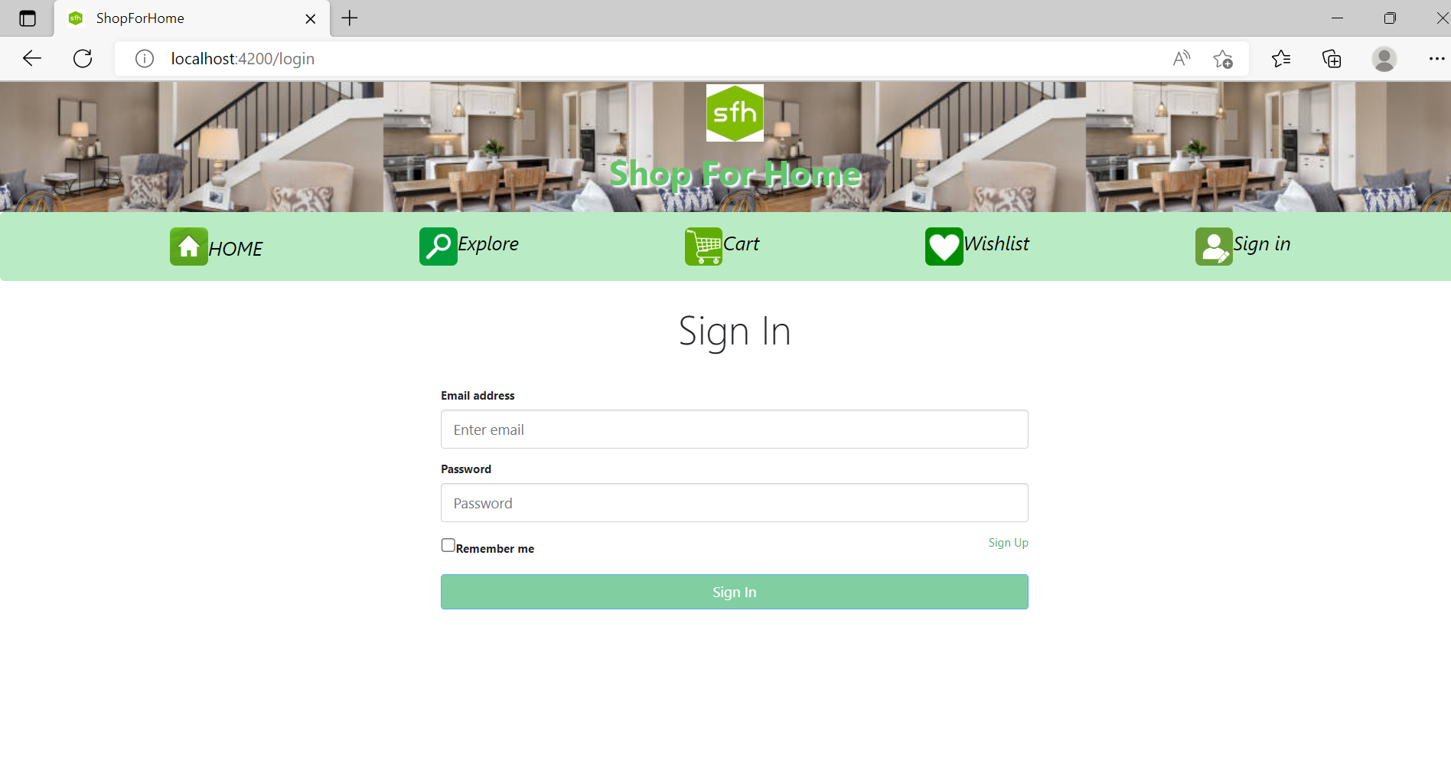
Sign In Functionality

Slide 26
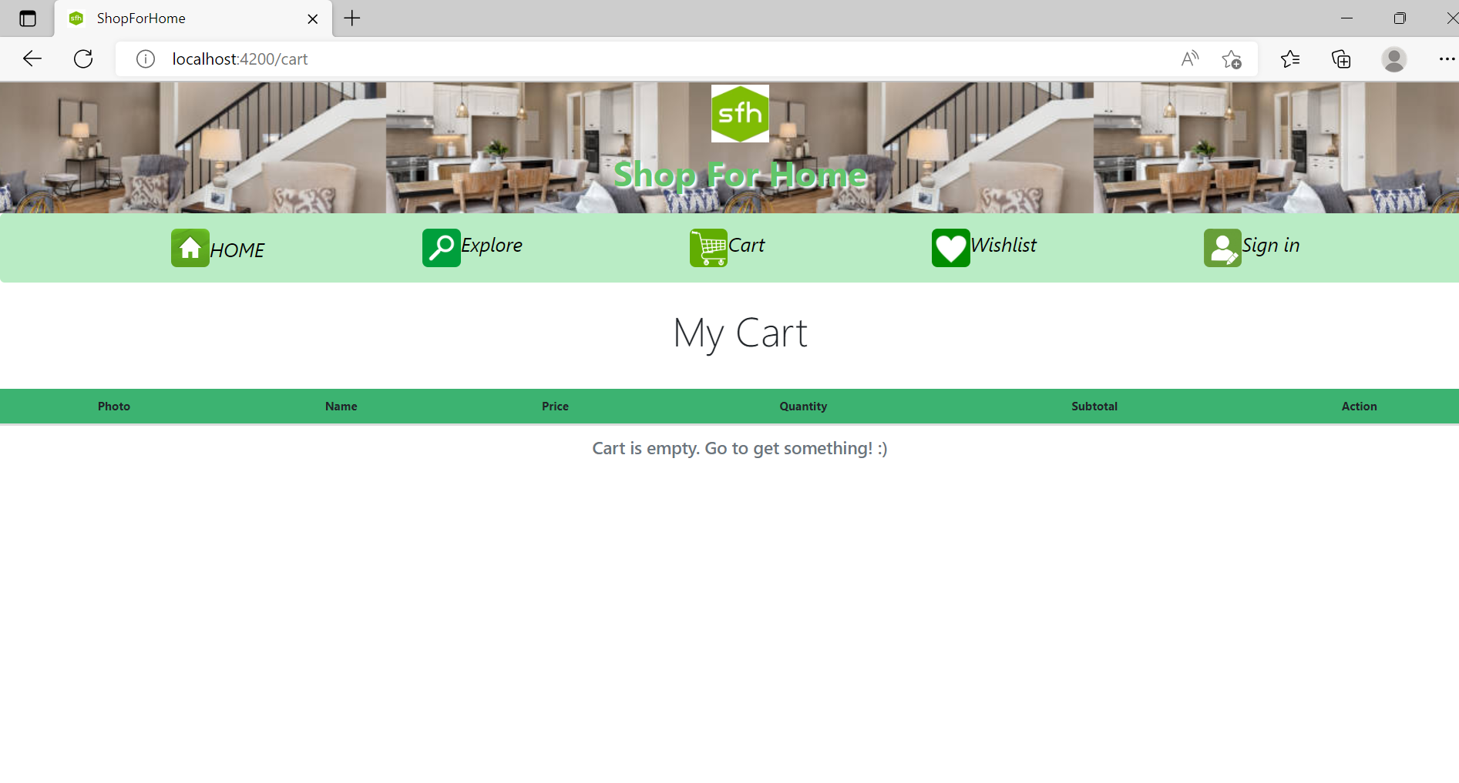
Add to cart Functionality

Slide 27
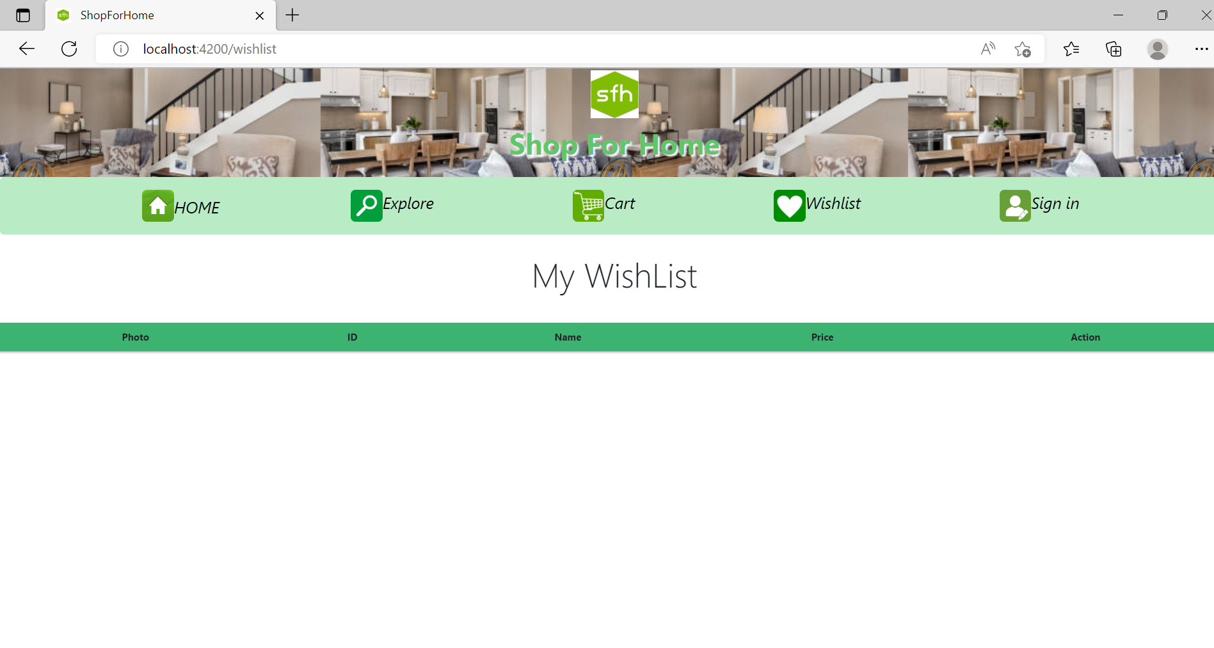
Wishlist Functionality

Slide 28
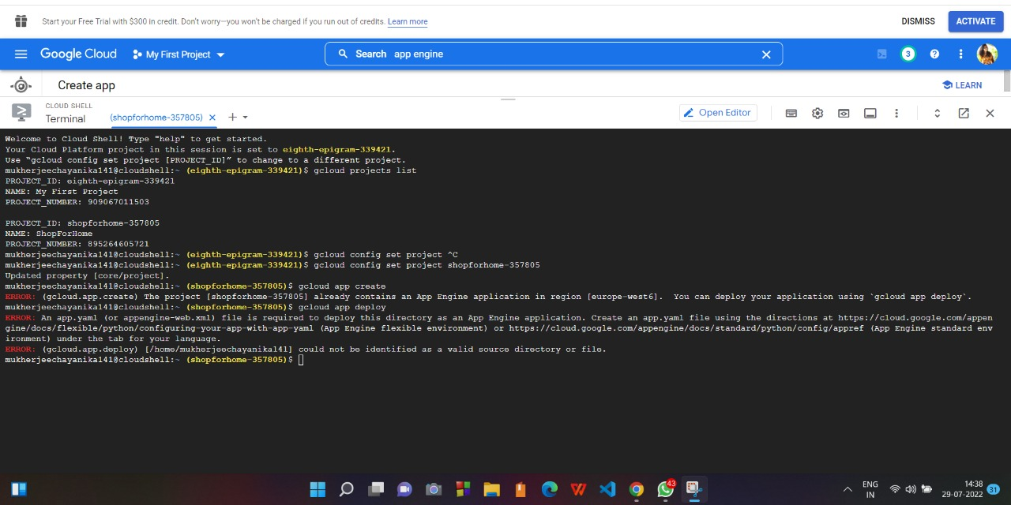
Error in deploying it to cloud

Slide 29


